Slide 1

EXPENSE TRACKER
Personal Finance Management System
Kurpa Devar: 24107065
Shravni Bhosale: 24107025
Shravani Karpe:24107047
Project Guide
Ms. Aavani Nair
Department of Computer Science Engineering
(Data Science)
A.P. Shah Institute of Technology, Thane
Academic Year: 2025-26

Slide 2
Outline
Introduction
Problem statement
System Design
Technologies and methodologies
Implementation
Conclusion
References

Slide 3
Introduction
Real-time Problem Observation:
- Students and individuals struggle with tracking daily expenses - Lack of simple, accessible expense management tools
- Manual record-keeping is time-consuming and error-prone
- Difficulty in analyzing spending patterns
Motivation:
-Need for digital solution to manage personal fazainances - Enable better financial decision-making
- Provide instant access to expense history
- Simplify budget tracking for students
Objectives:
- Develop web-based expense tracking application
- Implement database integration for persistent storagea
- Create user-friendly interface for expense management - Enable real-time calculation of total expenditure

Slide 4
Problem statement
Core Problem:
Individuals lack an efficient system to record, view, and analyze their daily expenses, leading to poor financial awareness and budget management.Describe the statement in elaboration mentioning all key points to be addressed by you.
Key Points to Address:
- Easy expense entry mechanism
- Categorized expense tracking
- Real-time data storage and retrieval - Total expenditure calculation
- Cross-platform accessibility

Slide 5
System Architecture
Three-Tier Architecture
Presentation Layer (Frontend):
- JSP pages with HTML/CSS/JavaScript
- User interface for data input and display
Application Layer (Backend):
- Java Servlets handling HTTP requests
- Business logic processing
- Data validation.
Application Layer (Backend):
- Java Servlets handling HTTP requests
- Business logic processing
- Data validation

Slide 6
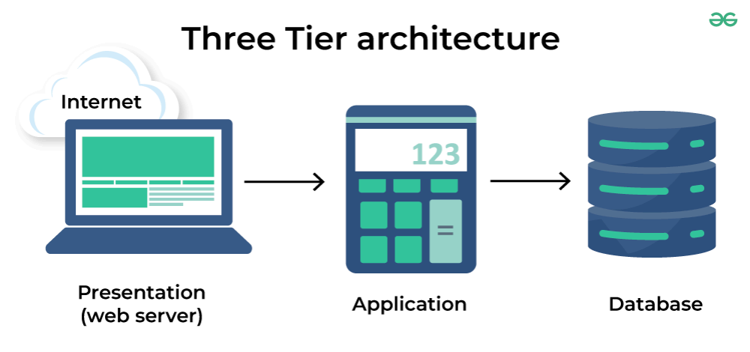

Slide 7
System Design -Component Diagram
Key Components:Model Layer:
Expense.java - Data model with attributes (id,
description, amount, category, date)
DAO Layer:
- ExpenseDAO.java
- Database operations (CRUD)
- Methods: addExpense(), getAllExpenses(),getTotalExpenses()
Controller Layer:
- AddExpenseServlet.java - Handles expense creation
- ViewExpensesServlet.java - Retrieves and display expenses
Utility Layer:
- DatabaseUtil.java
- Database connection management

Slide 8
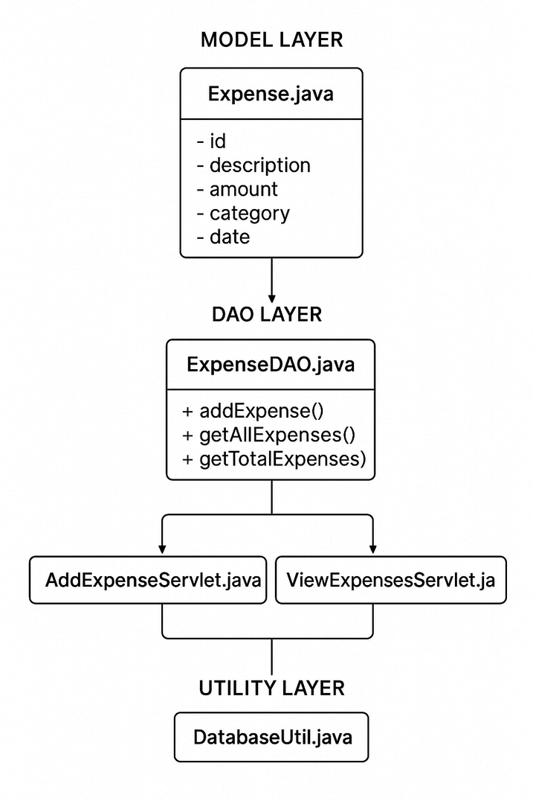

Slide 9
Database Design
Expense Table Schema:
- id (INT, PRIMARY KEY,AUTO_INCREMENT)
- description (VARCHAR, 255)
- amount (DECIMAL, 10,2)
- category (VARCHAR, 100)
- date (DATE)
- created_at (TIMESTAMP)
Categories Supported:
Food, Transport, Shopping, Bills,Entertainment,
Other

Slide 10
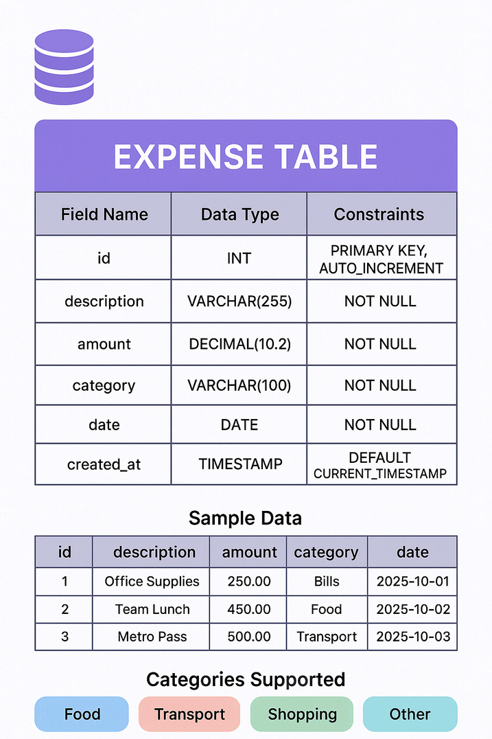

Slide 11
Technologies and methodologies
Frontend Technologies:
- HTML5 for structure
- CSS3 for styling and animations
- JavaScript for client-side validation Backend Technologies:
- Java JDK 11
- Java Servlets API 4.0
- JSP (JavaServer Pages) 2.2
Database:
- MySQL 8.0
- JDBC Driver for connectivity
Server:
- Apache Tomcat 9.0
Development Tools:
- Visual Studio Code
- MySQL Workbench

Slide 12
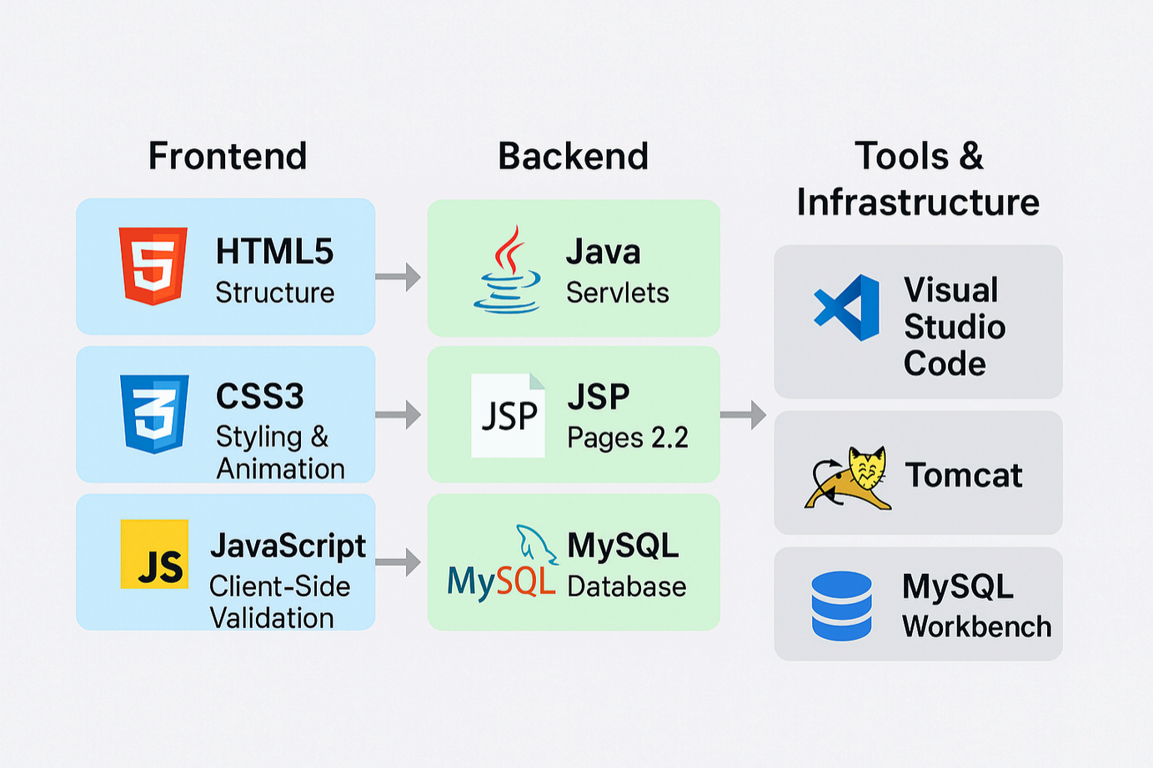

Slide 13
Implementation
Model-View-ControllerArchitecture:
Model:
-Expenseentityclasswithencapsulation
-Getter/settermethodsfordataaccess
View:
-index.jsp-Expenseentryform
-expenses.jsp-Expenselistdisplay
Controller:
-ServletsprocessHTTPrequests
-Forwarddatatoappropriateviews
-Handlebusinesslogic
DAOPattern:
-Separatesdatabaseoperations
-Reusabledataaccessmethods

Slide 14
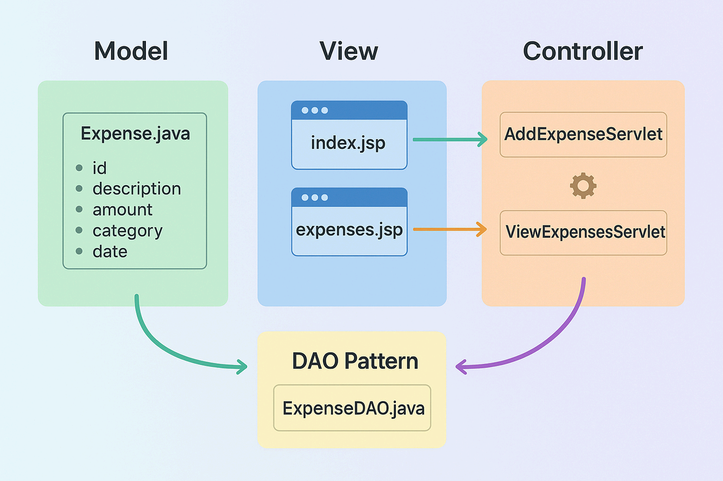

Slide 15
Key Features Implemented
Add Expense Functionality: - Form withdescription,amount, category,date fields - Client-side validation using JavaScript - Server-side processing via servlet - Success/error message display

Slide 16
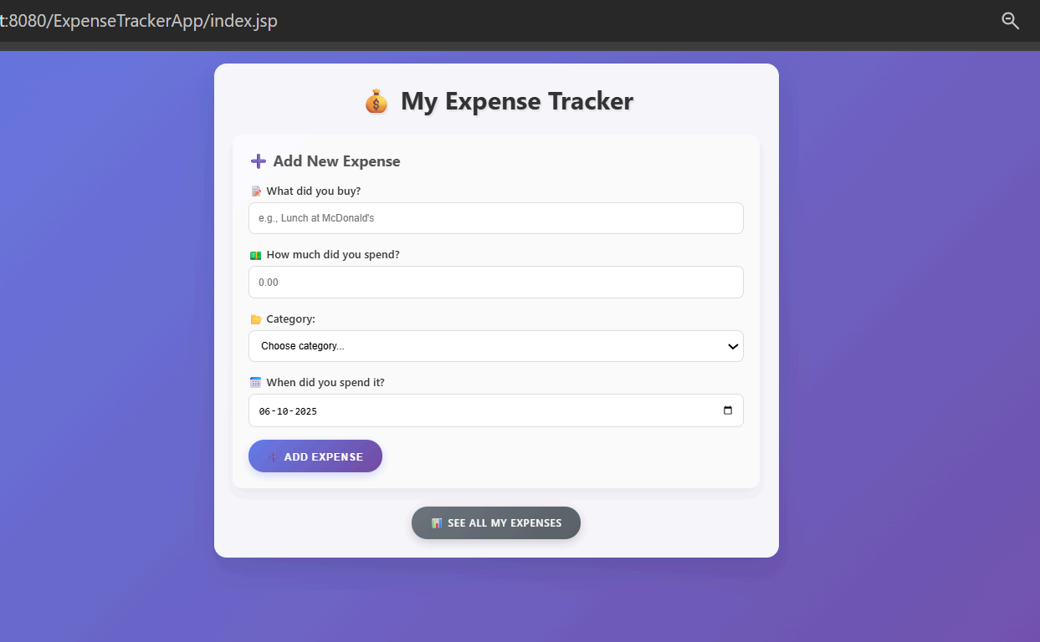

Slide 17
Key Features Implemented
View Expenses
Functionality:
- Tabular display of all expenses
- Automatic total calculation
- Sorted by date (newest first)
- Professional UI with gradient design

Slide 18
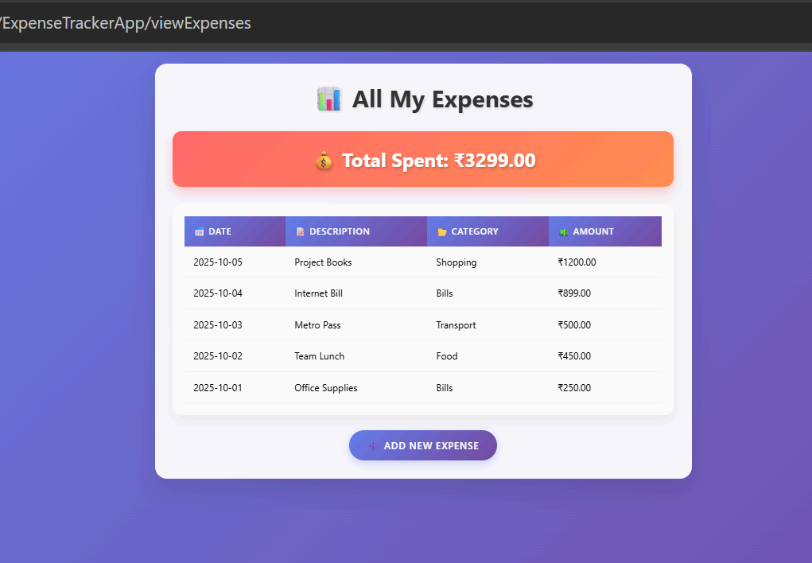

Slide 19
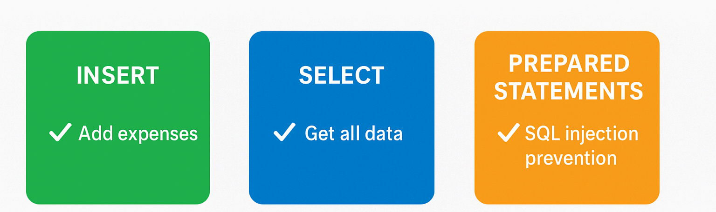
Key Features Implemented
Database
Operations:
- INSERT for adding expenses
- SELECT for retrieving data
- Prepared statements for SQL injection prevention

Slide 20
Testing and Results
Functional Testing:
- Successfully adds expenses to database
- Correctly displays all stored expenses
- Accurate total calculation
- Proper error handling
Performance:
- Fast response time (<1 second)
- Efficient database queries
- Smooth user experience
Browser Compatibility:
- Tested on Chrome, Firefox, Edge
- Responsive design works on different screen sizes

Slide 21
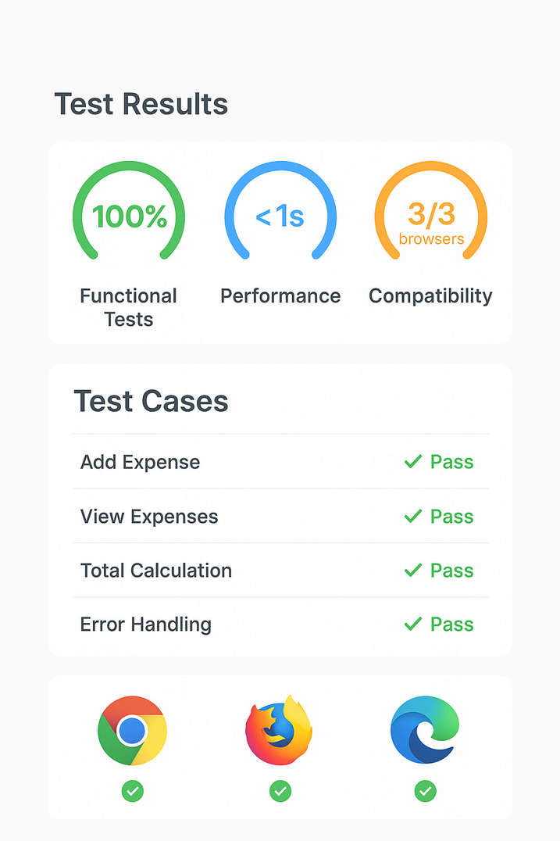

Slide 22
Conclusion
The Expense Tracker is a valuable tool designed to simplify and automate the process of managing personal finances. It allows users to efficiently record daily transactions, categorize expenses, and analyze spending patterns through graphical reports and summaries. This system not only minimizes manual effort but also reduces the chances of financial mismanagement by providing real-time insights into income and expenditure.
By promoting transparency and accountability, it encourages users to adopt better saving and budgeting habits. The system’s easy-to-use interface and data visualization features make it accessible for users of all age groups. In addition, its ability to generate monthly or yearly summaries helps in setting financial goals and tracking progress over time.
Overall, the Expense Tracker contributes significantly to improving personal financial literacy, ensuring users maintain control over their money, avoid unnecessary expenses, and move toward a more stable and planned financial future.

Slide 23
References
Oracle, "Java Servlet Technology Overview", Oracle Documentation, 2024.https://docs.oracle.com/javaee/7/tutorial/servlets.htm
.
Oracle, "JavaServer Pages Technology", Oracle Documentation, 2024.https://docs.oracle.com/javaee/7/tutorial/jsps.htm.
MySQL, "MySQL 8.0 Reference Manual", MySQL Documentation, 2024.https://dev.mysql.com/doc/refman/8.0/en/
Apache Software Foundation, "Apache Tomcat 9 Documentation", 2024.https://tomcat.apache.org/tomcat-9.0-doc/
Oracle, "JDBC Database Access", Oracle Java Tutorials, 2024.https://docs.oracle.com/javase/tutorial/jdbc/

Slide 24
Thank You...!!

